Slide 1
vLLM: Easy, Fast, and Cheap LLM Serving with PagedAttention
Roshan Thekiniath, Zhenqiao Song, Zhirui Wang
CMU
2024/3/25

Slide 2
Outline
Background and Related Work
Motivation
Method
Experiments
Takeaways

Slide 3
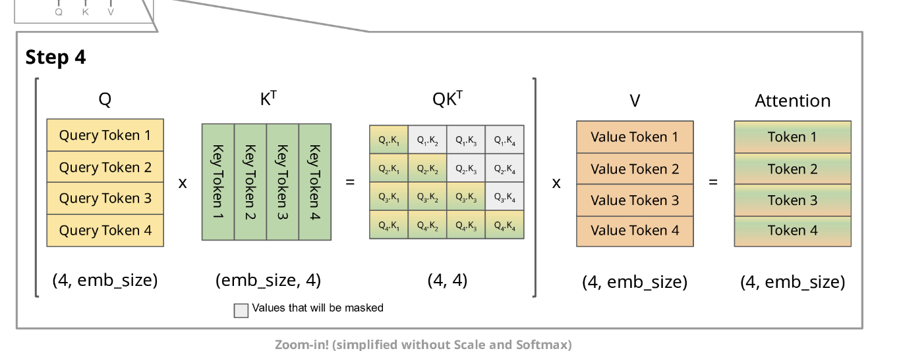
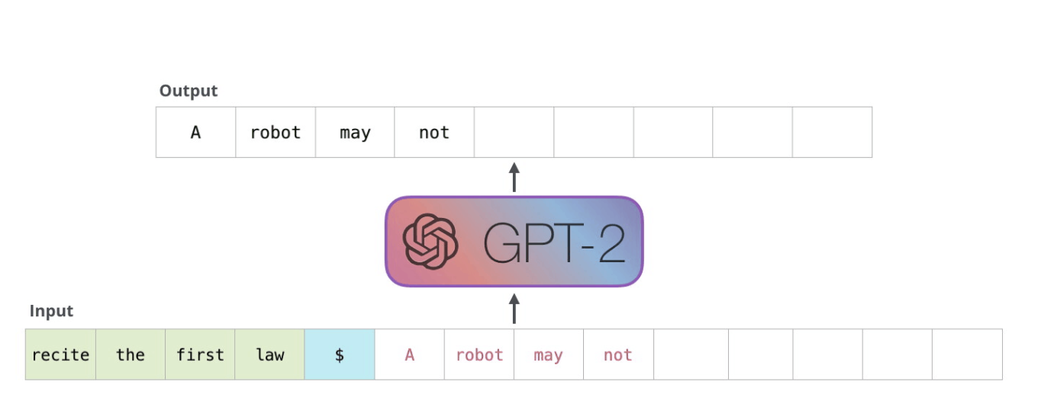
Background and Related Work
Large Language Serving
  Autoregressive generation
    Prompt phase
    Autoregressive generation phase
Notes:
For the prompt phase, the computation of prompt can be parallelized efficiently using matrix multiplication, while for autoregressive phase, each token is generated once per generation, and the previous key and values are cached, the computation is actually underutilized, making this procedure a memory-bound problem.
While batching the requests could significantly reduce the queueing delay and padding inefficiency, the total number of batched requests are still constrained by the GPU memory, which affect the responses delay a lot

Slide 4
Background and Related Work
Large Language Serving
  Batching Technologies
    Iteration-level batching instead of request-level
    Specific GPU kernels to eliminate the padding
    Constraints of the number of batched requests: Memory-Bound
Notes:
For the prompt phase, the computation of prompt can be parallelized efficiently using matrix multiplication, while for autoregressive phase, each token is generated once per generation, and the previous key and values are cached, the computation is actually underutilized, making this procedure a memory-bound problem.
While batching the requests could significantly reduce the queueing delay and padding inefficiency, the total number of batched requests are still constrained by the GPU memory, which affect the responses delay a lot

Slide 5
Background and Related Work
Memory Challenges in LLM Serving
  Large KV Cache
    Single Token: 2 * 5120 * 40 (layers) * 2 (fp16)->0.8MB
    Extremely long contexts (2048) -> 1.6GB
  Complex decoding algorithms
    Beam Search, Parallel Sampling, etc
    Shared context
  Dynamic lengths for auto-regressive
    Scheduling to swap KV cache in/out the GPU memory
    Fragmentation
Notes:
During the auto-regressive phase, only one token is calculated, while previous kV are cached. For some 13B model with 40 layers, the memory usage will need about 0.8 MB of memory, which means 1.6 GB is roughly needed for the 2k context.
And Complex decoding like beam searching will actually increase the memory usage for each requests. The fact of memory sharing is kind of not exploited in current systems.
Finally, dynamic increasing of outputs make this problem even harder, since the strategies for swapping KV cache will also be under consideration. (Think of CPU memory as some kind of storage)

Slide 6
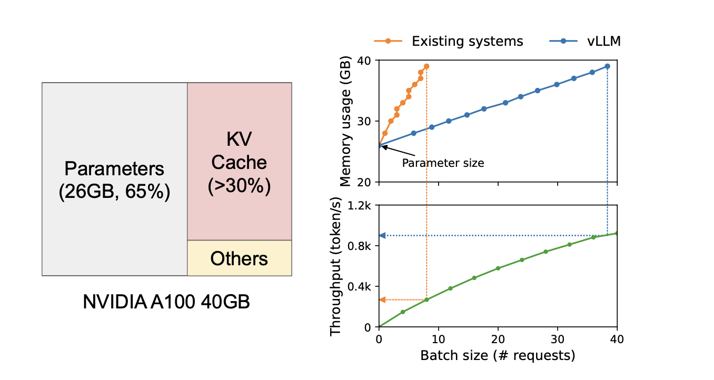
Background and Related Work
Memory Challenges in LLM Serving
Notes:
Only a some portion of gpu memory can be allocated for the KV cache, and the throughput is directly affected by the batch size.
From the blue line, by using the later vllm, the memory usage for each request is significantly reduced.

Slide 7
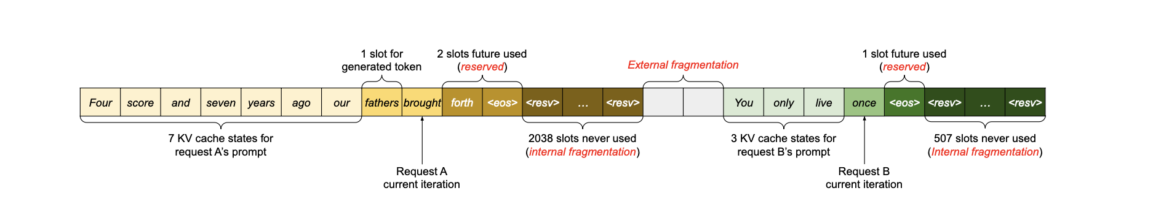
Background and Related Work
Fragmentations in Current Memory Management
Reserved: future used tokens
Internal: Over-provisioning slots (max_length 2048)
External: Buddy Allocator (Malloc Lab)
Notes:
For the prompt phase, the computation of prompt can be parallelized efficiently using matrix multiplication, while for autoregressive phase, each token is generated once per generation, and the previous key and values are cached, the computation is actually underutilized, making this procedure a memory-bound problem.
While batching the requests could si ginasigina

Slide 8
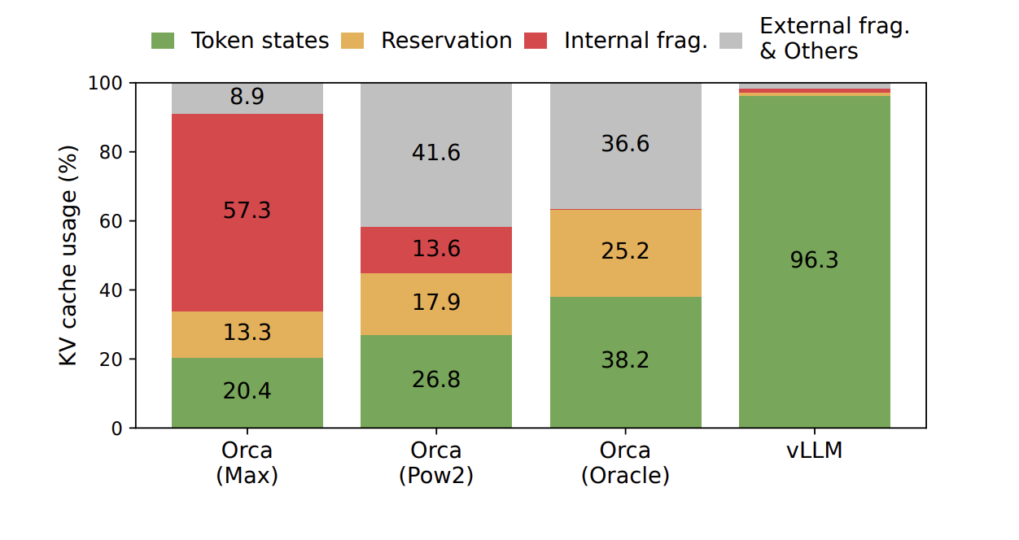
Background and Related Work
Fragmentations in Current Memory Management

Slide 9
Outline
Background and Related Work
Motivation
Method
Experiments
Takeaways

Slide 10
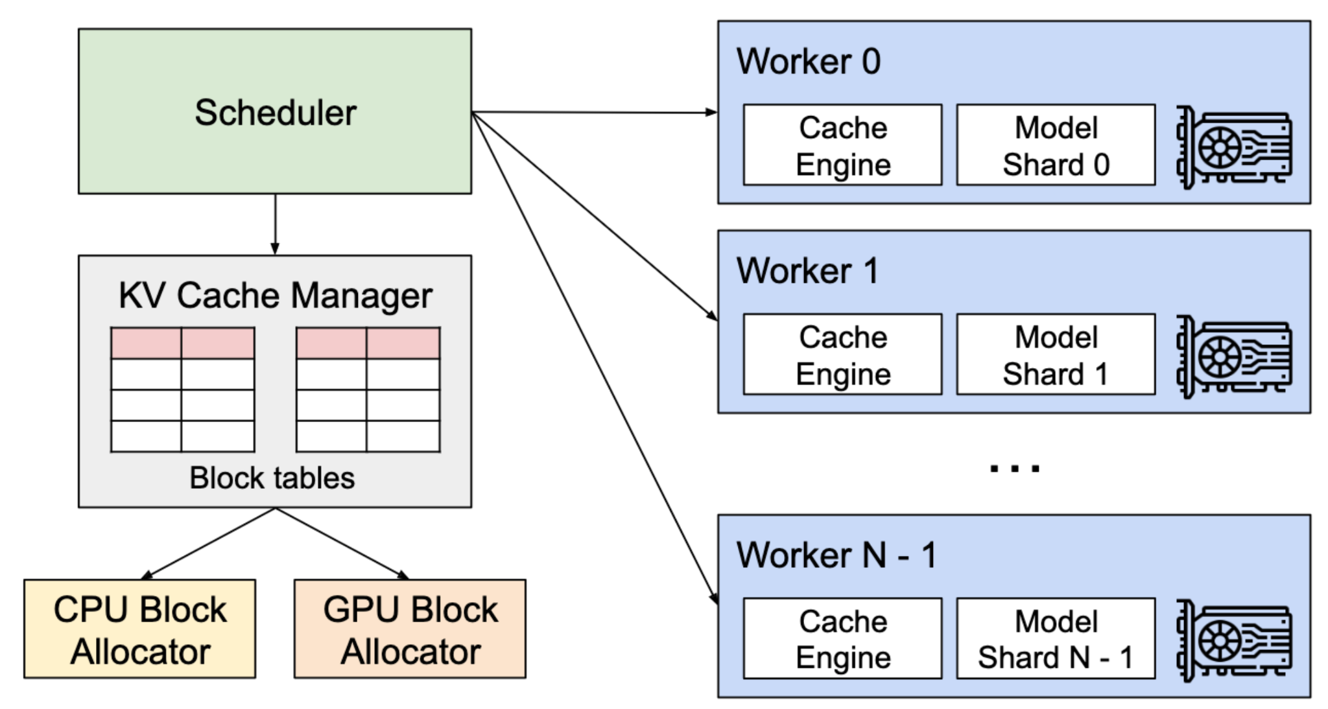
vLLM System Overview
High-throughput distributed LLM serving engine
Centralized Scheduler: coordinates distributed GPU workers
KV Cache Manager: manages the KV cache in a blockwise fashion
PagedAttention: computes attention using a non-contiguous KV cache

Slide 11
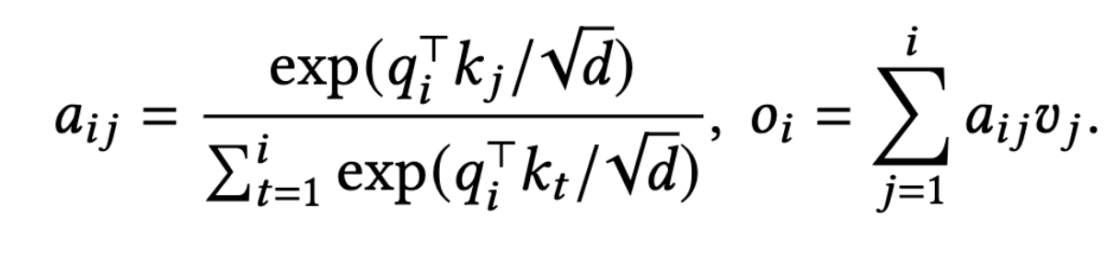
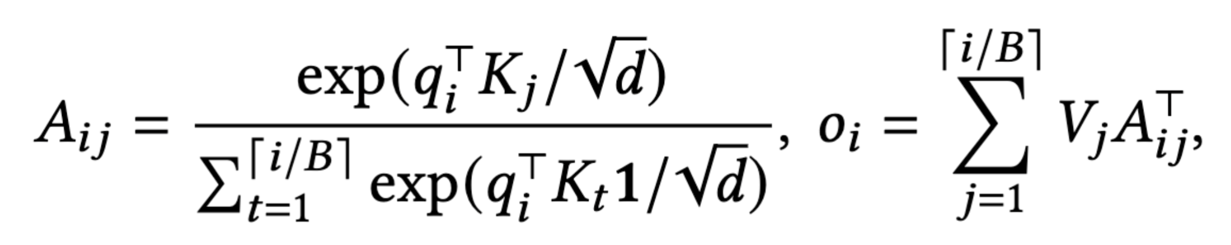
PagedAttention
KV cache is split into multiple blocks
Each block contains key and value vector for a fixed number of tokens
During the attention computation each block is fetched separately
Traditional Attention
PagedAttention

Slide 12
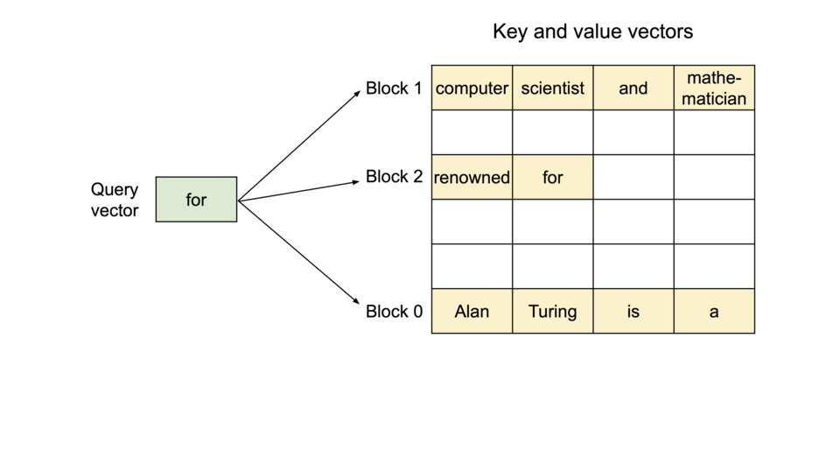
PagedAttention
Traditional Attention
PagedAttention

Slide 13
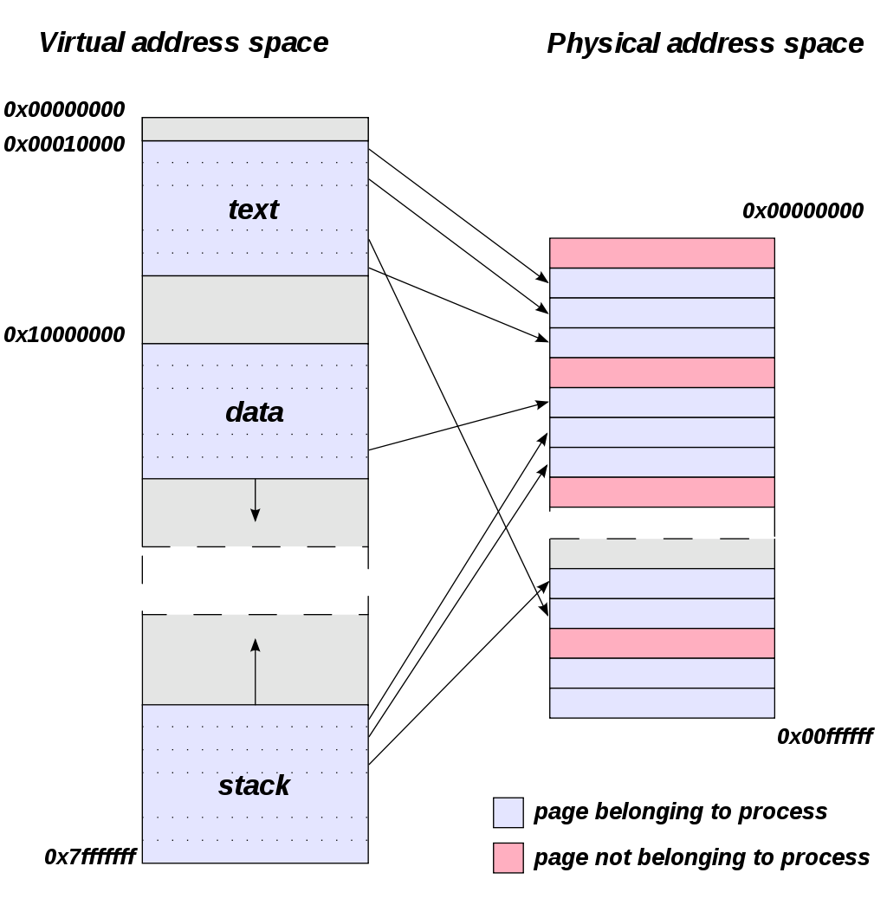
Virtual Memory and Paging
Virtual Memory: memory management technique that provides abstraction over physical memory
Memory is partitioned into fixed-sized pages (e.g., 4096 bytes)
Page Table: mapping from blocks of virtual memory to blocks of physical memory
Each process gets independent memory address space
Can exceed capacity of physical memory
Permits swapping to disk

Slide 14
KV Cache Manager
Analogous to paging in operating systems
  KV Blocks = OS Pages
  Logical KV Blocks = Virtual Pages
  Physical KV Blocks = Physical Pages
  Tokens = Bytes
  Requests = Processes
KV cache manager builds tables mapping logical KV blocks to physical KV blocks
Logical KV blocks are filled left to right, so last block may not be filled
Physical KV blocks may be stored non-contiguously on GPU memory and can be freed and allocated independently with minimal fragmentation

Slide 15
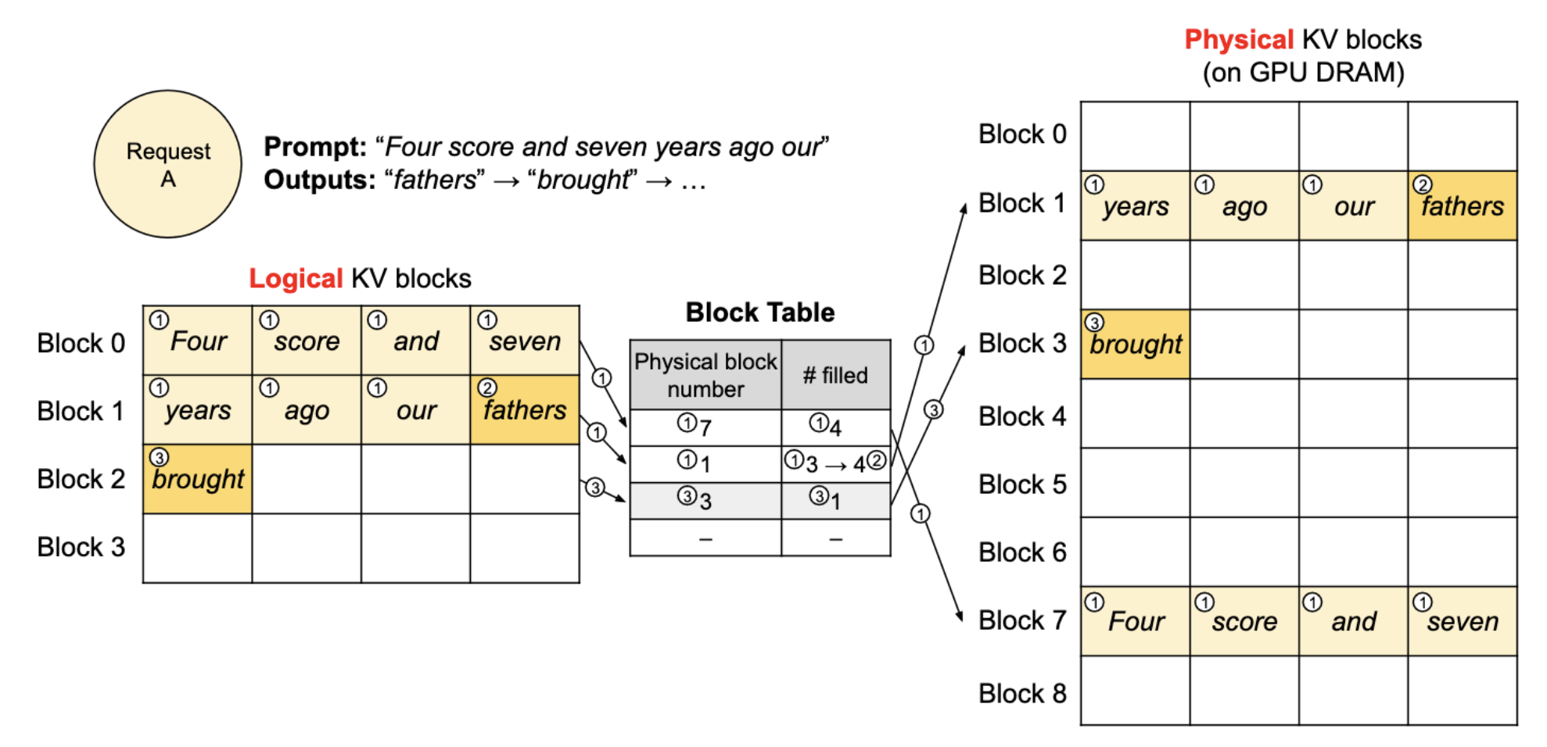
KV Cache Manager

Slide 16
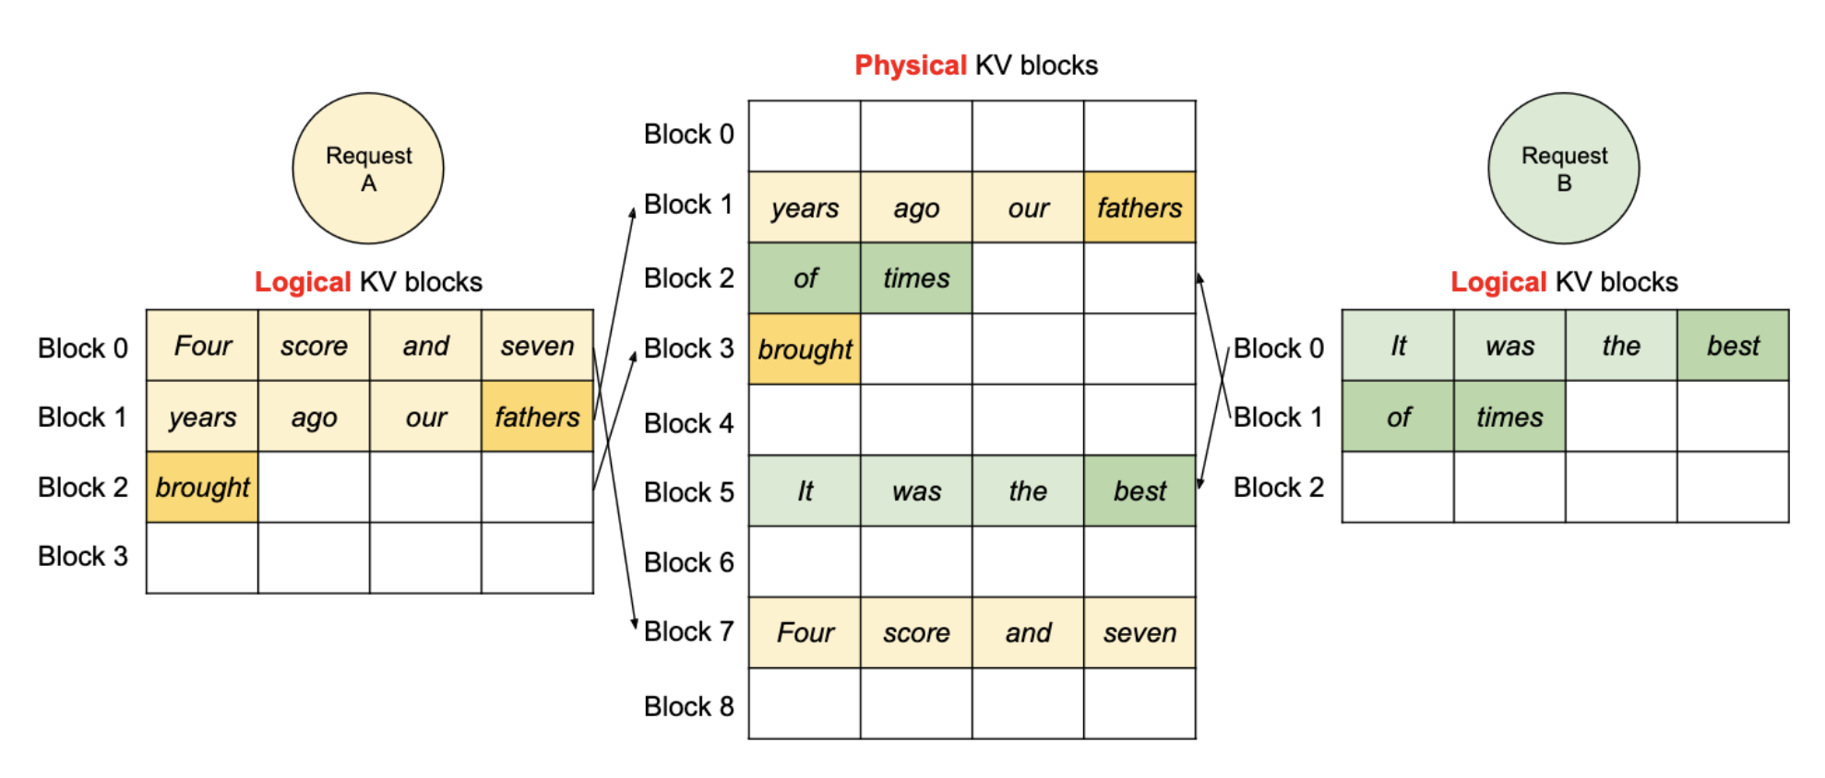
KV Cache Manager

Slide 17
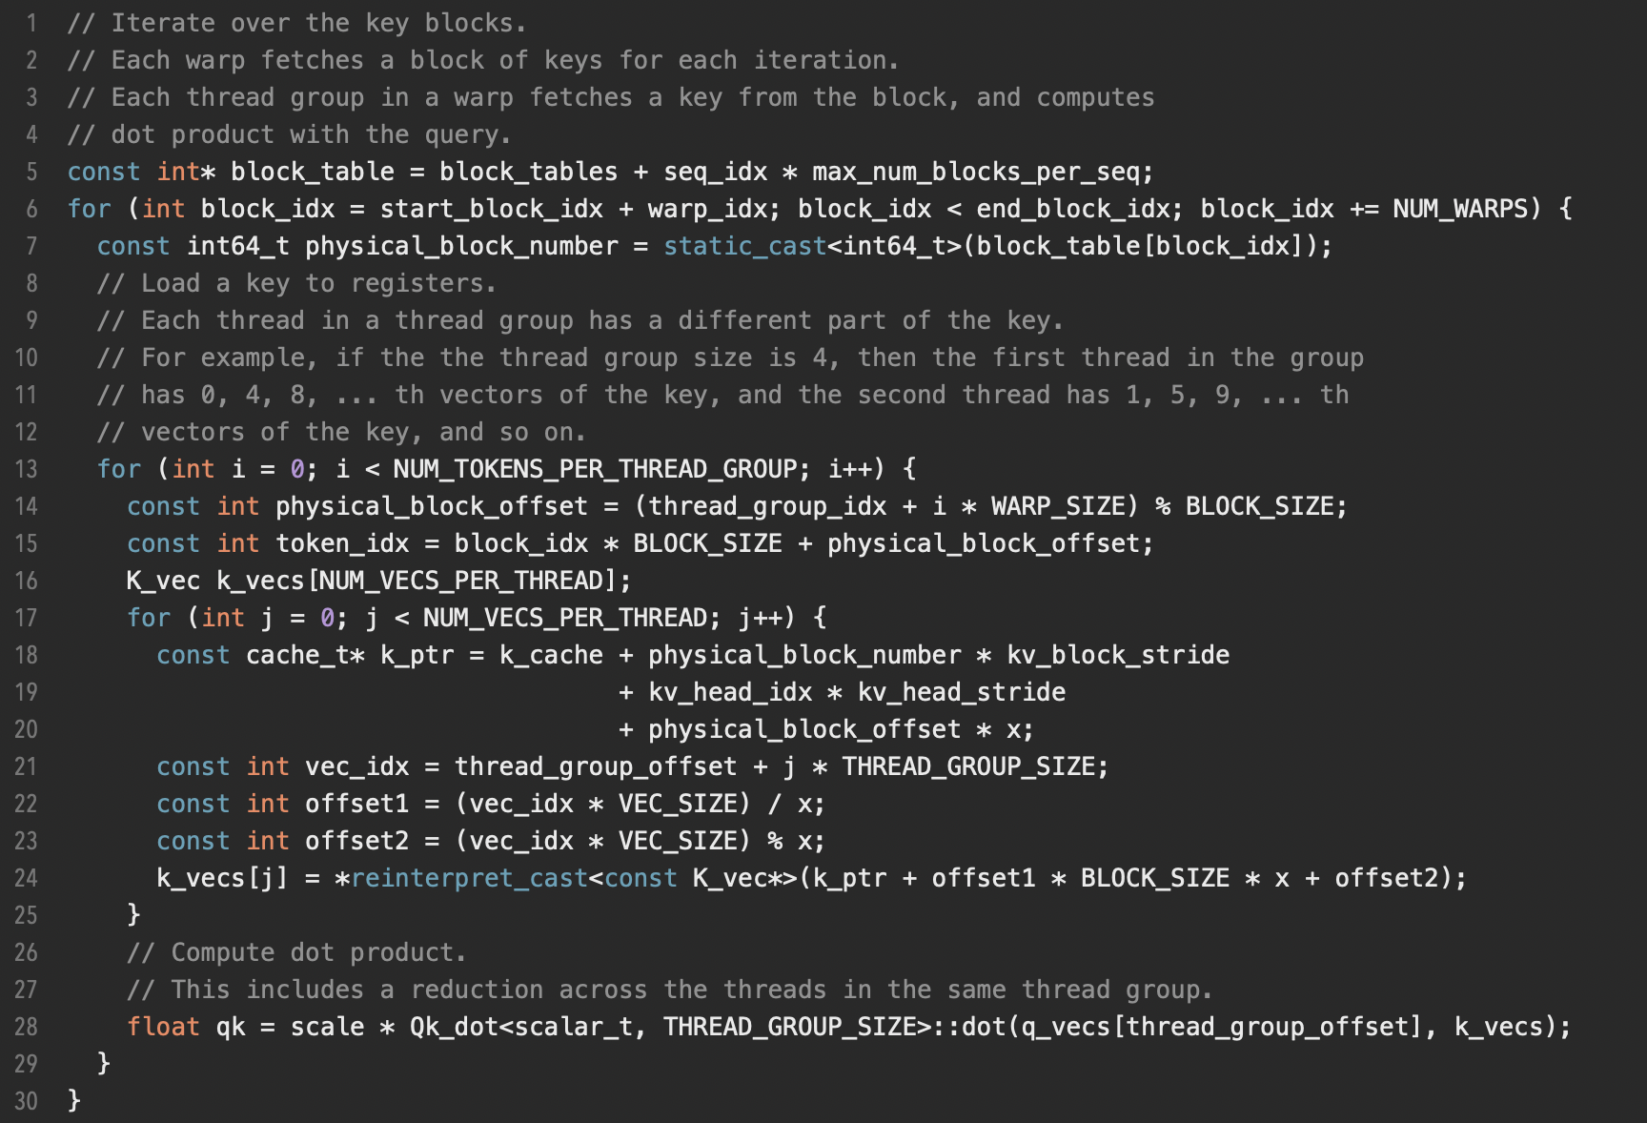
PagedAttention CUDA Kernel

Slide 18
PagedAttention CUDA Kernel
// Iterate over the key blocks.
// Each warp fetches a block of keys for each iteration.
// Each thread group in a warp fetches a key from the block, and computes
// dot product with the query.
const int* block_table = block_tables + seq_idx * max_num_blocks_per_seq;
for (int block_idx = start_block_idx + warp_idx; block_idx < end_block_idx; block_idx += NUM_WARPS) {
const int64_t physical_block_number = static_cast<int64_t>(block_table[block_idx]);
// Load a key to registers.
// Each thread in a thread group has a different part of the key.
// For example, if the the thread group size is 4, then the first thread in the group
// has 0, 4, 8, ... th vectors of the key, and the second thread has 1, 5, 9, ... th
// vectors of the key, and so on.
for (int i = 0; i < NUM_TOKENS_PER_THREAD_GROUP; i++) {
const int physical_block_offset = (thread_group_idx + i * WARP_SIZE) % BLOCK_SIZE;
const int token_idx = block_idx * BLOCK_SIZE + physical_block_offset;
K_vec k_vecs[NUM_VECS_PER_THREAD];
for (int j = 0; j < NUM_VECS_PER_THREAD; j++) {
const cache_t* k_ptr = k_cache + physical_block_number * kv_block_stride
+ kv_head_idx * kv_head_stride
+ physical_block_offset * x;
const int vec_idx = thread_group_offset + j * THREAD_GROUP_SIZE;
const int offset1 = (vec_idx * VEC_SIZE) / x;
const int offset2 = (vec_idx * VEC_SIZE) % x;
k_vecs[j] = *reinterpret_cast<const K_vec*>(k_ptr + offset1 * BLOCK_SIZE * x + offset2);
}
// Compute dot product.
// This includes a reduction across the threads in the same thread group.
float qk = scale * Qk_dot<scalar_t, THREAD_GROUP_SIZE>::dot(q_vecs[thread_group_offset], k_vecs);
}
}

Slide 19
Decoding with PagedAttention and vLLM
For each decoding iteration, the scheduler selects a set of new candidate sequences and allocates physical blocks
The KV cache engine updates corresponding block tables
Then, all sequences (including both new requests as well as partially generated sequences) are concatenated as input for the LLM
PagedAttention kernel performs parallel computation of attention using the existing KV cache and stores the new generated KV cache

Slide 20
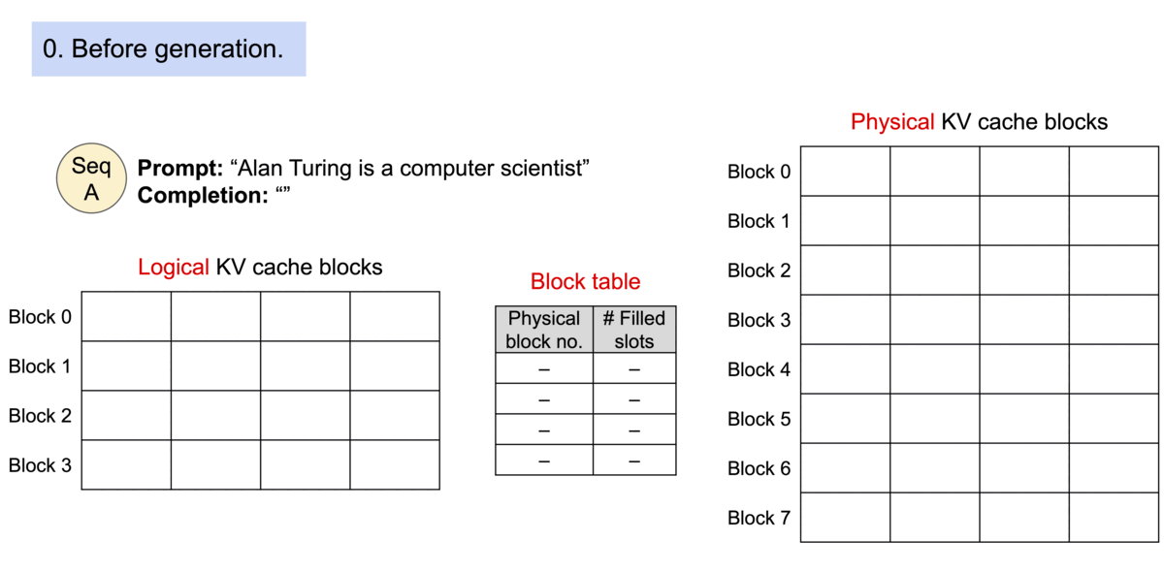
Decoding with PagedAttention and vLLM

Slide 21
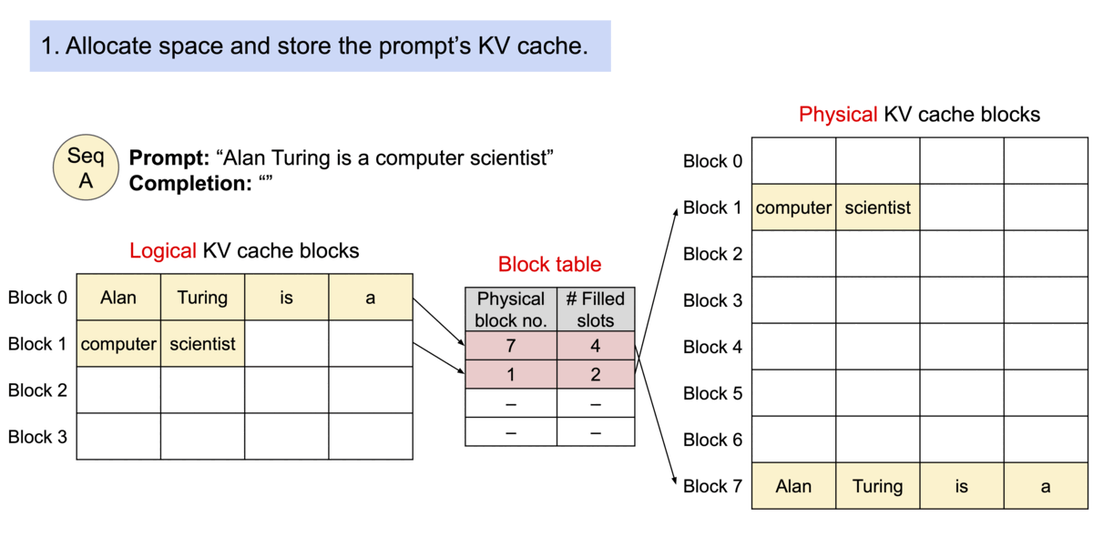
Decoding with PagedAttention and vLLM

Slide 22
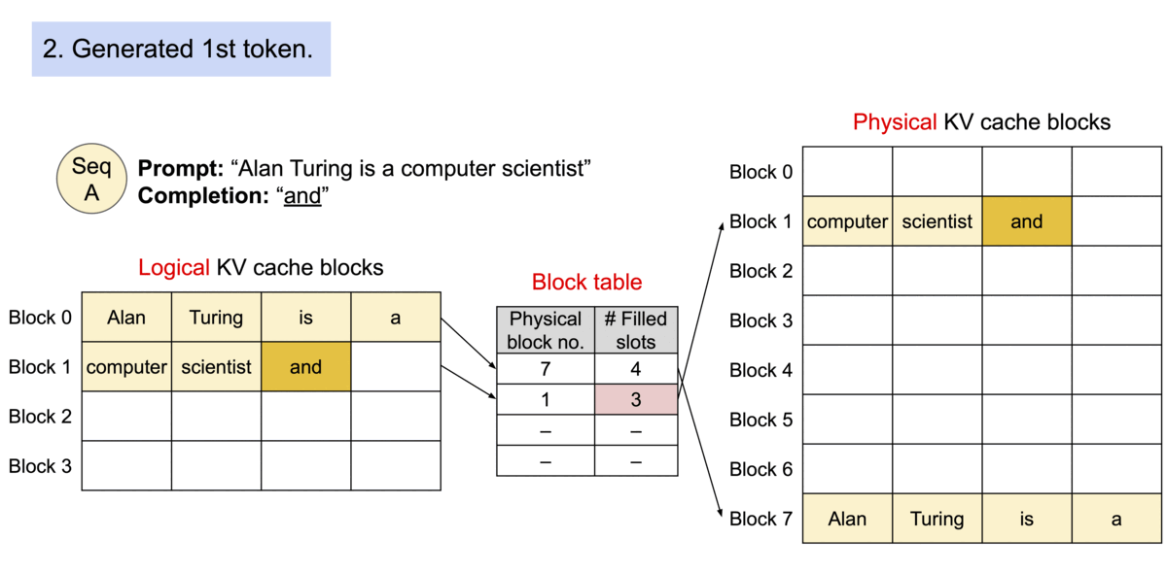
Decoding with PagedAttention and vLLM

Slide 23
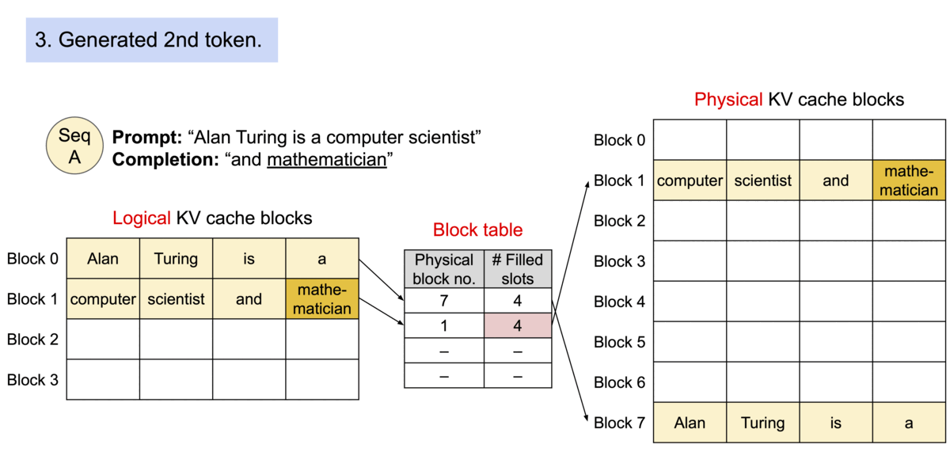
Decoding with PagedAttention and vLLM

Slide 24
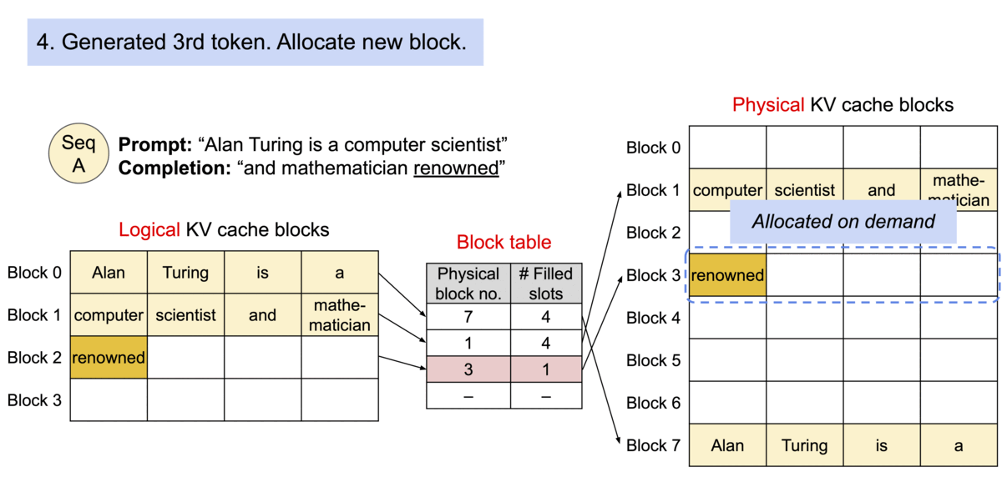
Decoding with PagedAttention and vLLM

Slide 25
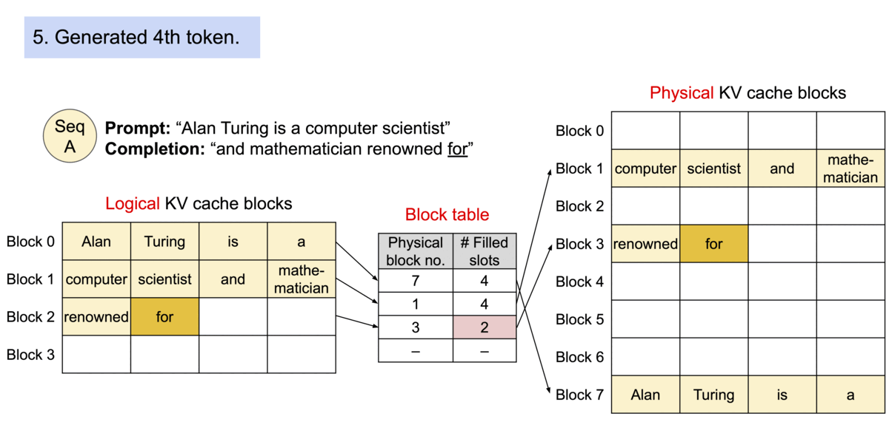
Decoding with PagedAttention and vLLM

Slide 26
Application to Other Decoding Scenarios
Decoding strategies may share input tokens, so the KV cache can be partially reused
  Parallel Sampling
  Beam Search
  Shared Prefix
vLLM architecture can handle arbitrary access patterns with multiple decoding scenarios simultaneously

Slide 27
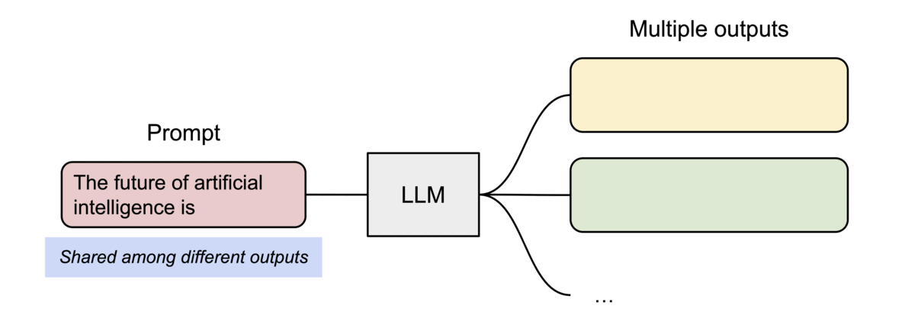
Parallel Sampling
Single prompt, multiple outputs
Keys and values for the prompt tokens are repeated across each sample
Uses reference counting for reused pages
Only clones pages on write

Slide 28
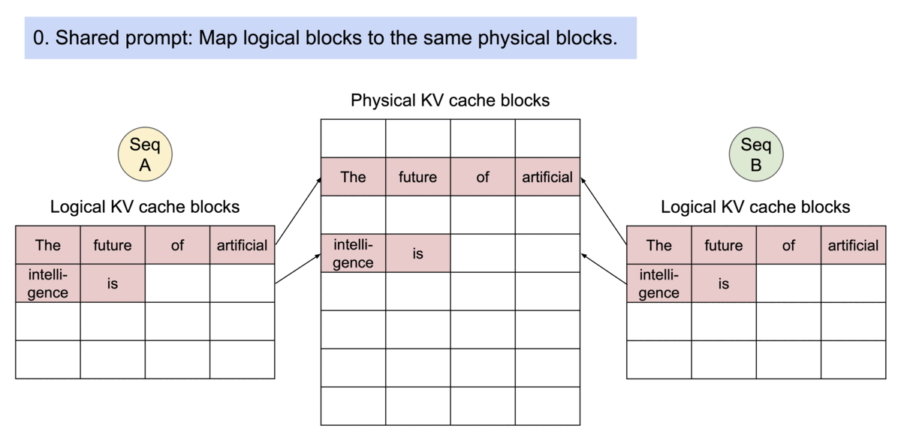
Parallel Sampling

Slide 29
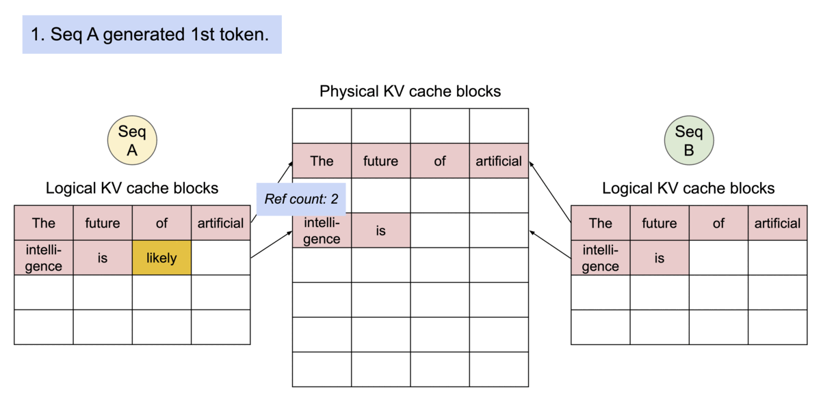
Parallel Sampling

Slide 30
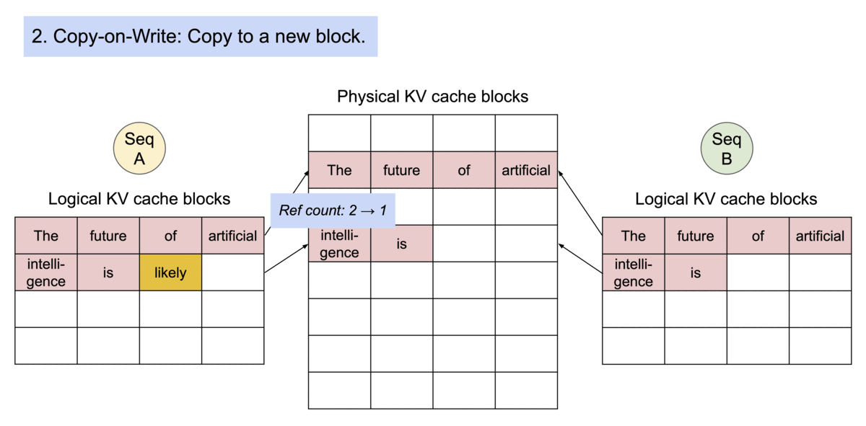
Parallel Sampling

Slide 31
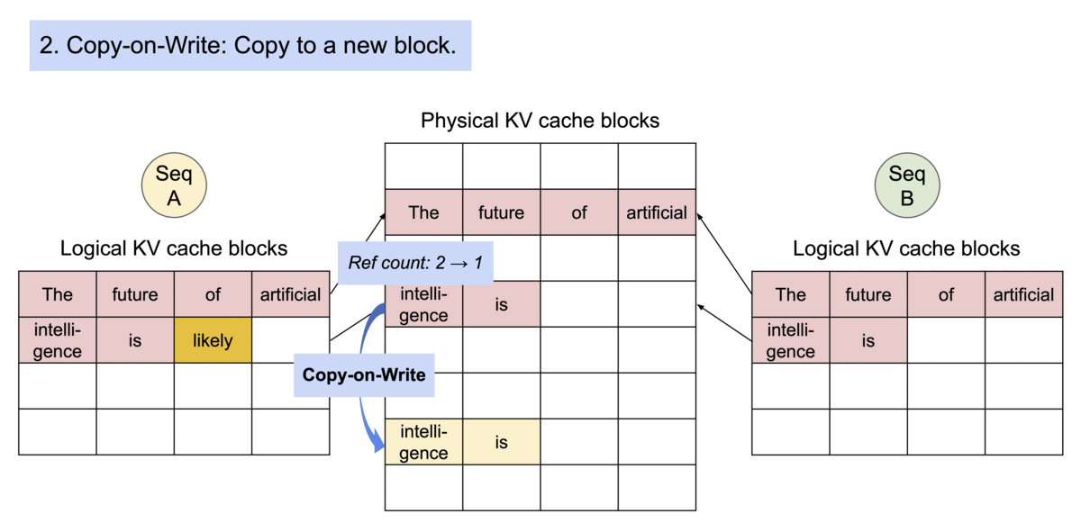
Parallel Sampling

Slide 32
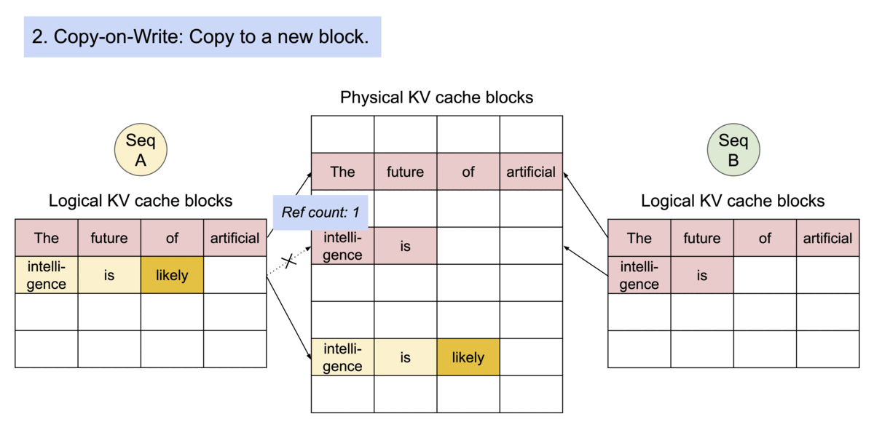
Parallel Sampling

Slide 33
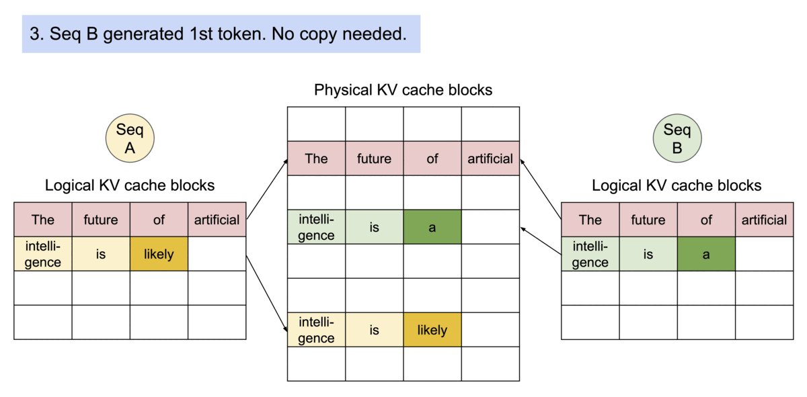
Parallel Sampling

Slide 34
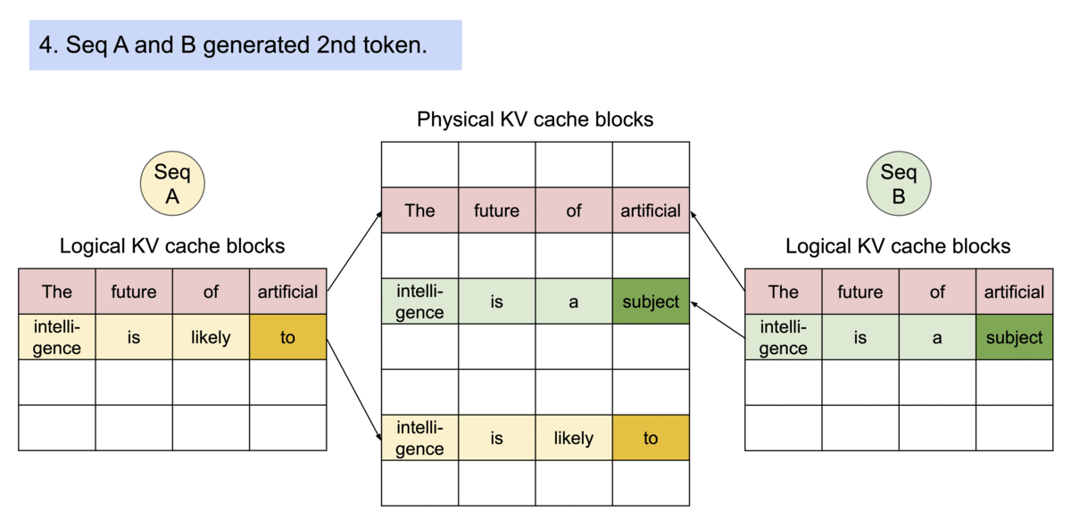
Parallel Sampling

Slide 35
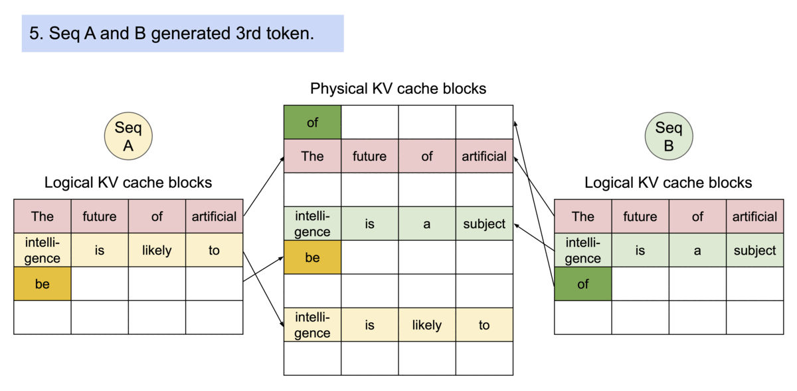
Parallel Sampling

Slide 36
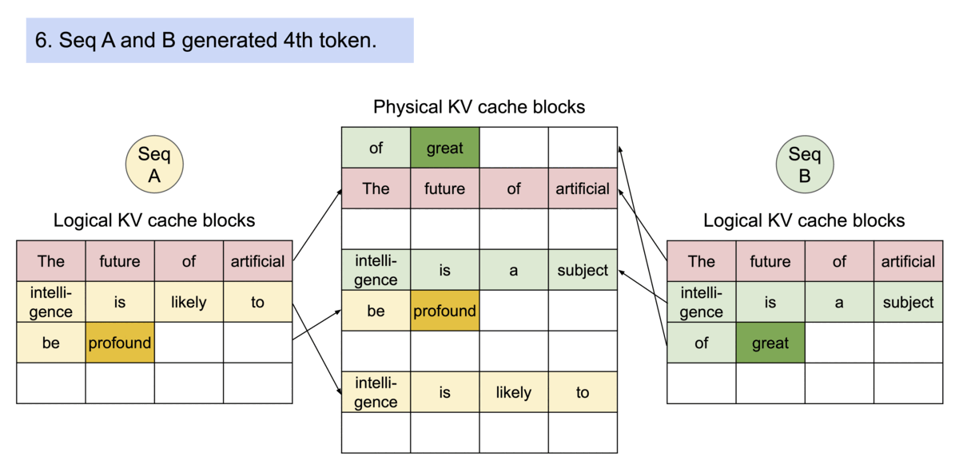
Parallel Sampling

Slide 37
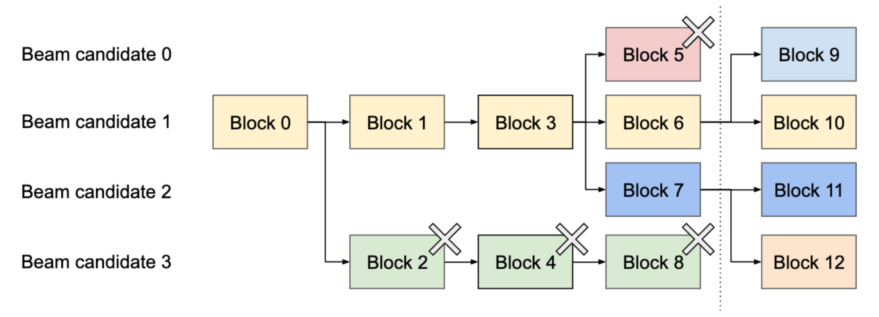
Beam Search
Maintains top-k sequences at each time step
May share the initial tokens (like parallel sampling) as well as future generated tokens (e.g., Block 0, 1, 3)
Generated sequences may split or terminate in arbitrary ways

Slide 38
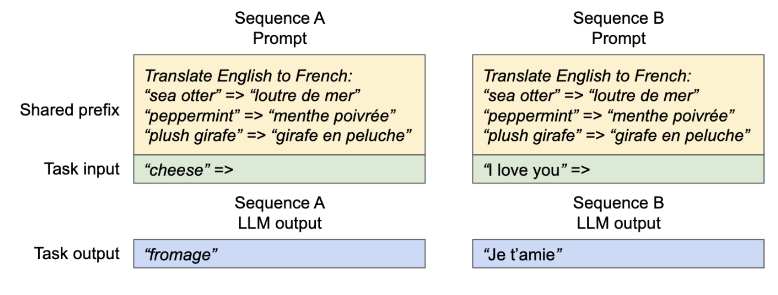
Shared Prefix
Many prompting techniques require shared prefixes
  Few-shot tasks
  System prompt
KV cache can be precomputed and treated like a shared resource
Last block is clone on write

Slide 39
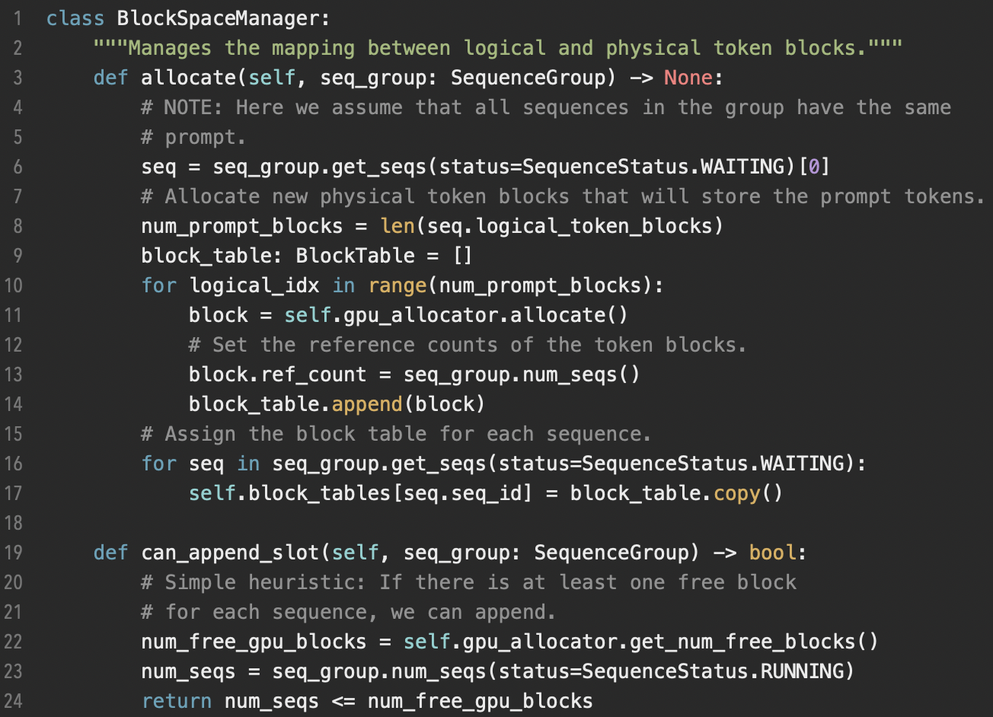
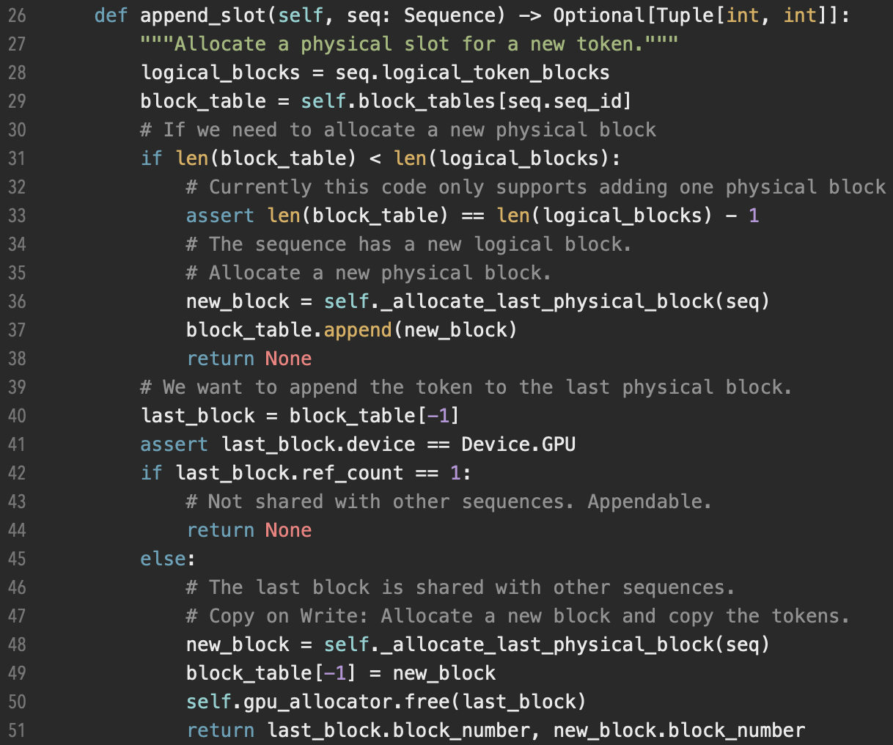
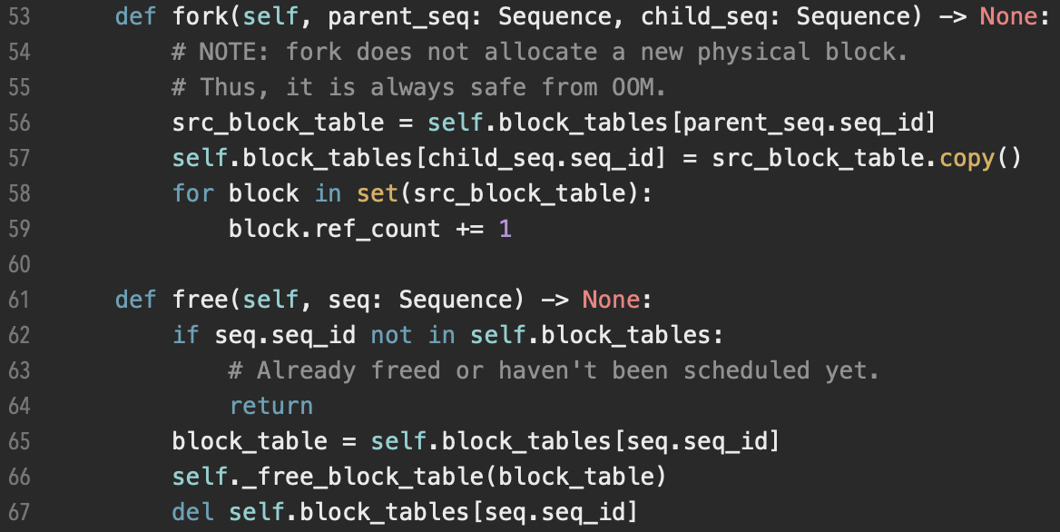
KV Cache Manager Code

Slide 40
KV Cache Manager Code
class BlockSpaceManager:
"""Manages the mapping between logical and physical token blocks."""
def allocate(self, seq_group: SequenceGroup) -> None:
# NOTE: Here we assume that all sequences in the group have the same
# prompt.
seq = seq_group.get_seqs(status=SequenceStatus.WAITING)[0]
# Allocate new physical token blocks that will store the prompt tokens.
num_prompt_blocks = len(seq.logical_token_blocks)
block_table: BlockTable = []
for logical_idx in range(num_prompt_blocks):
block = self.gpu_allocator.allocate()
# Set the reference counts of the token blocks.
block.ref_count = seq_group.num_seqs()
block_table.append(block)
# Assign the block table for each sequence.
for seq in seq_group.get_seqs(status=SequenceStatus.WAITING):
self.block_tables[seq.seq_id] = block_table.copy()
def can_append_slot(self, seq_group: SequenceGroup) -> bool:
# Simple heuristic: If there is at least one free block
# for each sequence, we can append.
num_free_gpu_blocks = self.gpu_allocator.get_num_free_blocks()
num_seqs = seq_group.num_seqs(status=SequenceStatus.RUNNING)
return num_seqs <= num_free_gpu_blocks
def append_slot(self, seq: Sequence) -> Optional[Tuple[int, int]]:
"""Allocate a physical slot for a new token."""
logical_blocks = seq.logical_token_blocks
block_table = self.block_tables[seq.seq_id]
# If we need to allocate a new physical block
if len(block_table) < len(logical_blocks):
# Currently this code only supports adding one physical block
assert len(block_table) == len(logical_blocks) - 1
# The sequence has a new logical block.
# Allocate a new physical block.
new_block = self._allocate_last_physical_block(seq)
block_table.append(new_block)
return None
# We want to append the token to the last physical block.
last_block = block_table[-1]
assert last_block.device == Device.GPU
if last_block.ref_count == 1:
# Not shared with other sequences. Appendable.
return None
else:
# The last block is shared with other sequences.
# Copy on Write: Allocate a new block and copy the tokens.
new_block = self._allocate_last_physical_block(seq)
block_table[-1] = new_block
self.gpu_allocator.free(last_block)
return last_block.block_number, new_block.block_number
def fork(self, parent_seq: Sequence, child_seq: Sequence) -> None:
# NOTE: fork does not allocate a new physical block.
# Thus, it is always safe from OOM.
src_block_table = self.block_tables[parent_seq.seq_id]
self.block_tables[child_seq.seq_id] = src_block_table.copy()
for block in set(src_block_table):
block.ref_count += 1
def free(self, seq: Sequence) -> None:
if seq.seq_id not in self.block_tables:
# Already freed or haven't been scheduled yet.
return
block_table = self.block_tables[seq.seq_id]
self._free_block_table(block_table)
del self.block_tables[seq.seq_id]

Slide 41
Scheduling and Preemption
First-come-first-serve scheduling policy
  Ensures fairness
  Prevents starvation
Preempting may be required when physical memory blocks are fully occupied
  Latest requests are preempted first
  All blocks of within a request (which may contain multiple sequences) are simultaneously evicted
  Blocks are either swapped or recomputed

Slide 42
Swapping
Standard method used by OS for virtual memory
  Pages are copied from main memory to disk
For vLLM, GPU physical blocks are copied to the CPU RAM physical blocks
Once other requests have completed and GPU memory becomes available, physical blocks are copied from CPU RAM back to GPU memory

Slide 43
Recomputation
Discards the KV cache for the preempted sequence
Recomputes the KV cache when the sequence is rescheduled
  Latency for recomputation is much less than original latency since all previously generated tokens are saved
May be faster or slower than paging
  Depends on bandwidth between CPU memory and GPU memory
  Depends on GPU computational power

Slide 44
Distributed Execution
Uses model parallelism to provide distributed execution across multiple GPUs
Megatron-LM style tensor model parallelism strategy
Can use a single centralized KV cache manager
  Each model shard processes same set of tokens
  Each worker has a KV cache for same positions, but only stores the data for the specific attention heads they need
No extra synchronization required for scheduling or managing cache

Slide 45
Outline
Background and Related Work
Motivation
Method
Experiments
Takeaways

Slide 46
Experiments
Implementation Details
Experimental Setup and Evaluation Metrics
Different Testing Scenarios
Ablation Study

Slide 47
Implementation Details
End-to-end serving system
  FastAPI fronted
  GPU-based inference engine
Code
  8.5k lines Python code
    The schedular and block manager
  2k lines of CUDA code
    Key operations – PagedAttention
Distributed GPU workers - NCCL

Slide 48
Additional Kernel Optimization
Fused reshape and block write
  KV cache’s block-wise reshape in a single kernel at each layer
Fusing block read and attention
  Attention kernel in Faster Transformer
Fused block copy
  Batch the copy operations for different blocks into a single kernel

Slide 49
Decoding Algorithm
Enabling different decoding strategies
  Greedy, Sampling, Beam Search
Implementation
  Fork, append, free
  Example – parallel sampling
    Fork – copy sequence from one to sample size
    Append
    Free – sequences meeting stopping criterion

Slide 50
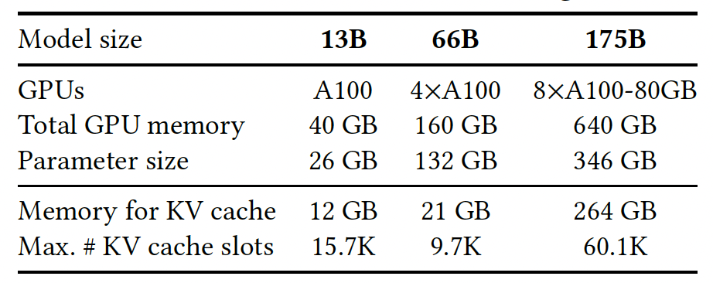
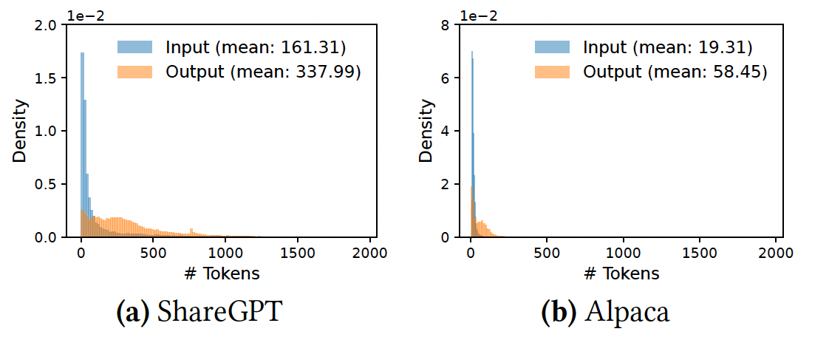
Experimental Setup
OPT
LLaMA-13B
Evaluation models
Datasets
Longer sequences & higher variance

Slide 51
Experimental Setup
Baselines
  FasterTransformer
  Orca
    Orca (Oracle) – ground truth length
    Orca (Pow2) – x2
    Orca (Max) – 2048 tokens
Evaluation metrics
  Normalized latency (s/token)

Slide 52
Different Testing Scenarios
Basic Sampling (One sample / request)
Parallel Sampling / Beam Search
Shared Prefix
Chatbot (Longer prompts)

Slide 53
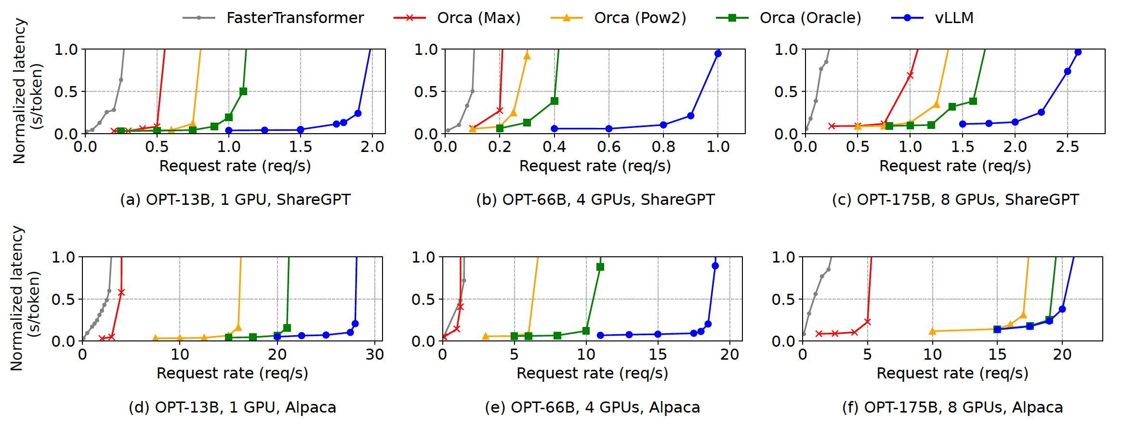
Basic Sampling
Even for Orca (Oracle) with ground truth length, vLLM has higher request rates with 1.7x – 2.7x! vLLMs has more efficient memory usage!

Slide 54
Basic Sampling
vLLM advantage is more obvious when sequence is longer. As shorter sequences enable larger batch size

Slide 55
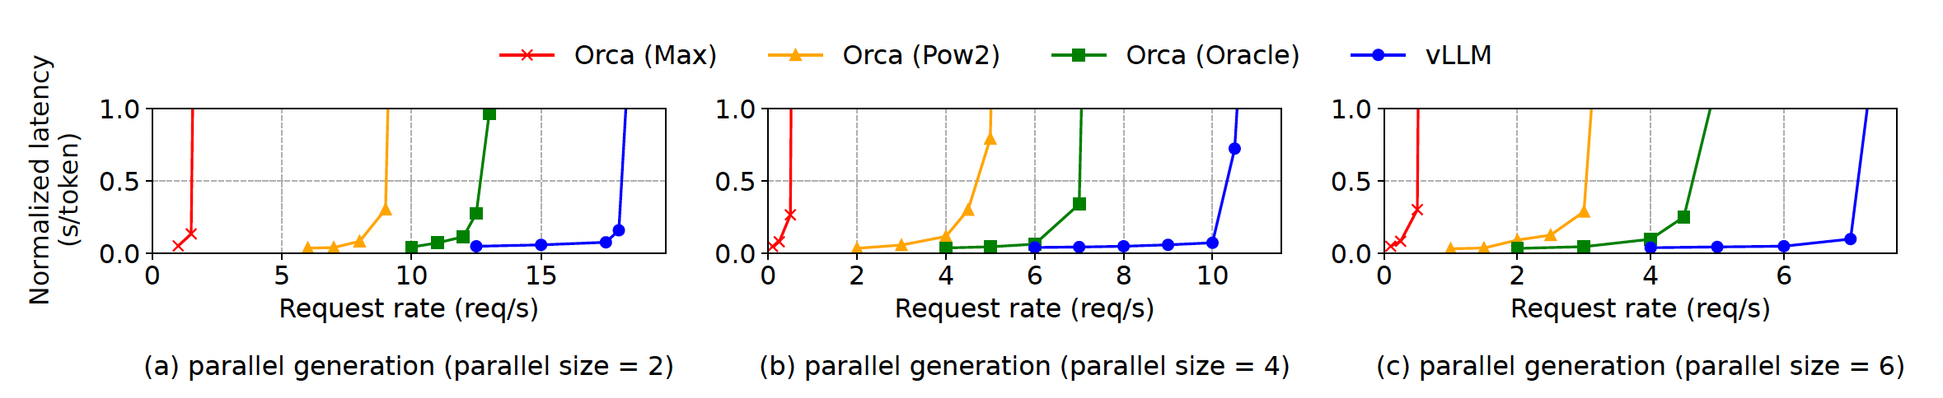
Parallel Sampling
Share KV-cache
vLLM gets more benefits when sample size gets larger

Slide 56
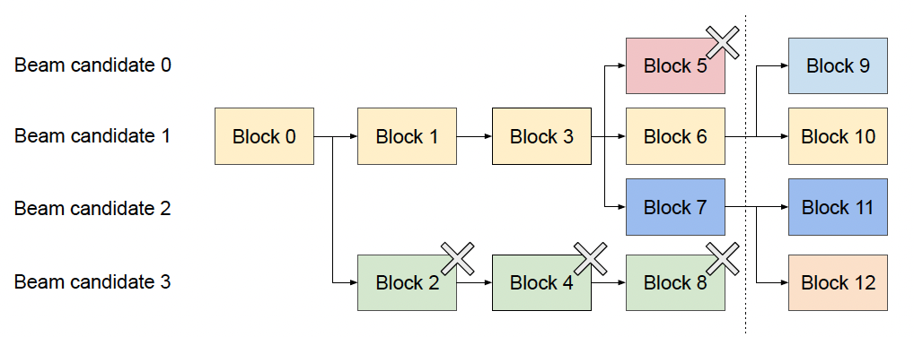
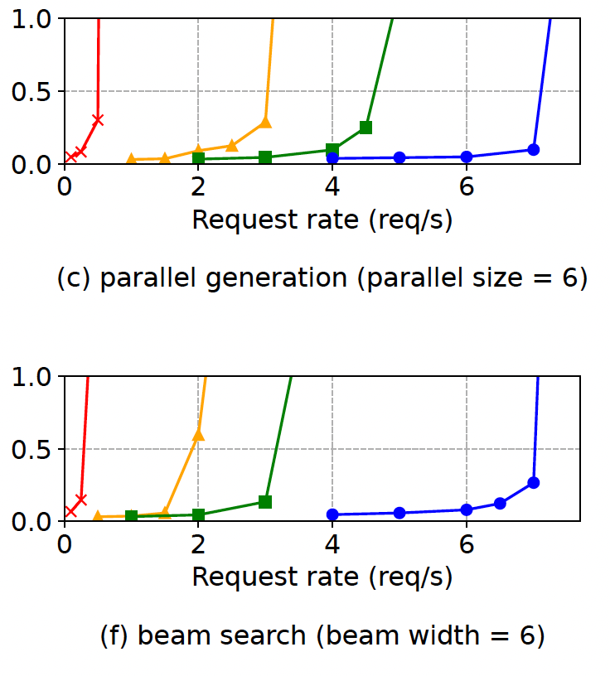
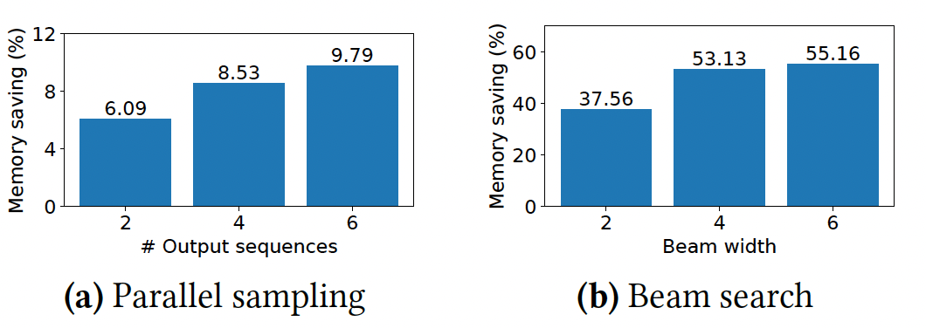
Beam Search
More KV-cache sharing

Slide 57
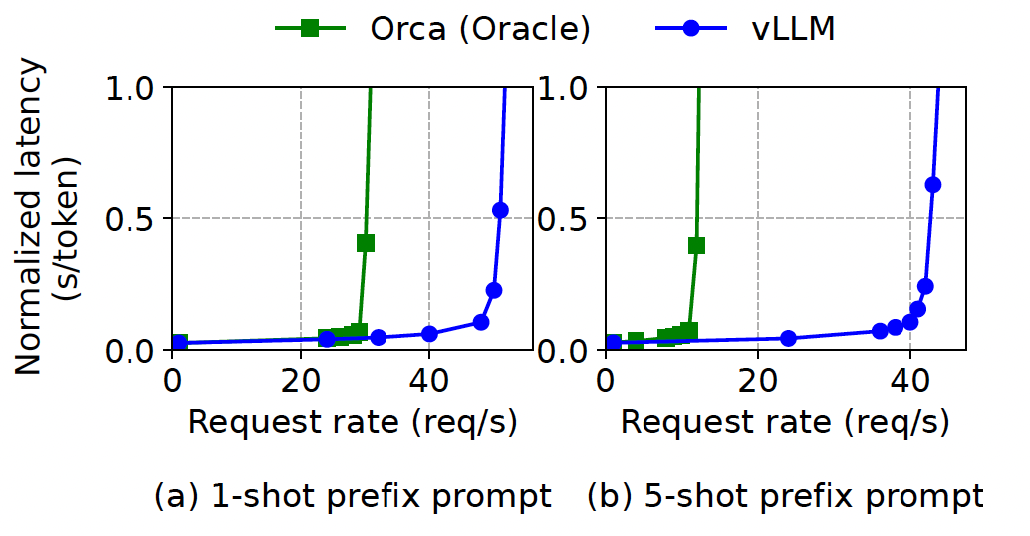
Shared Prefix
Settings
  WMT16 En-De
  LLaMA-13B
  One-shot & Few-shot (5) ICL
One-shot: 1.67X
Few-shot: 3.58X
Sharing more saves more

Slide 58
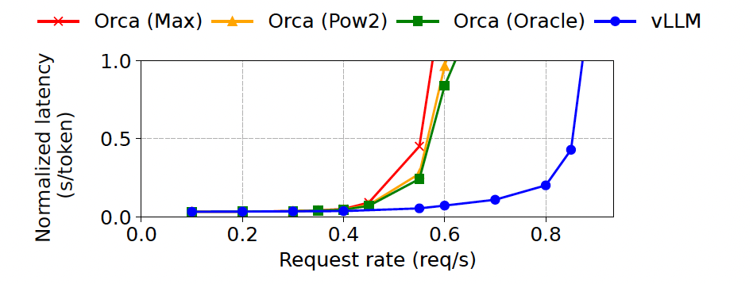
ChatBot
Settings
  ShareGPT
    Concatenate chatting history and user query
  OPT-13B
  1024 tokens
Orca always reserve 1024 token space.

Slide 59
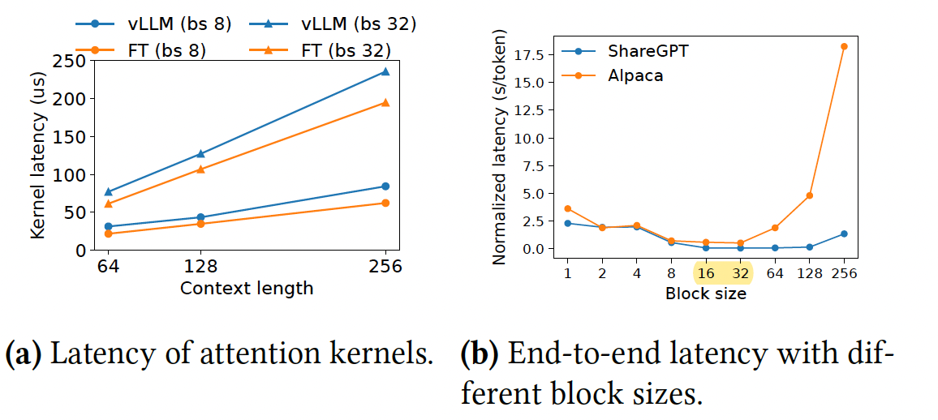
Ablation Study
Additional kernel optimization leads to 20-26% higher latency
Trade-off between parallelism and sharing
16-32 works best for both datasets; To make fully memory sharing, block size of 16 is a good choice

Slide 60
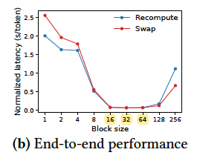
Ablation Study: Swap V.S. Recomputation
Smaller block size works better for Recomputation; larger for swapping
16-64 works well for both

Slide 61
Outline
Background and Related Work
Motivation
Method
Experiments
Takeaways

Slide 62
Takeaways
Summarization
  More efficient memory allocation through reshaping KV blocks
  PagedAttention – new attention mechanism operating on KV cache
  vLLM – a distributed LLM serving engine building upon PagedAttention

Slide 63
Takeaways
Advantage
  Efficient memory allocation
  KV cache could be non-contiguous
Disadvantage
  vLLM works better in long sequence scenarios
    Prompt is long
    Few-shot gets more benefits than one-shot
    In shorter sequence scenario, it might be compute-bound, leading to no performance improvement
  Some hyper-parameter like the block size will affect the performance

Slide 64
Thanks for listening!

